Slide 1
A Detailed Analysis on Start-ups
Introduction
Agenda
Start-ups - a brief overview
Results on different factors
Insights Learned
Conclusion
by
Sivasankar. A

Slide 2
Introduction
This Data Analysis is all about the study of Start-ups based on
Locations
Sectors
Broader Themes
Total Revenue they made
Market presence of the Start-ups.
Customer Requirements

Slide 3
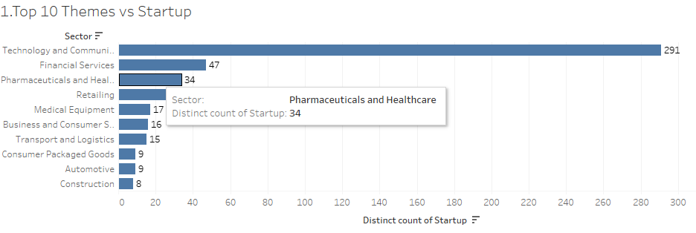
Top 10 Themes of Start-ups

Slide 4
Top 10 Themes of Start-ups
The Previous Slide describes the Top 10 Themes based on the Start-ups.
The Insight from the slide was the Technology and communication is having huge no of start-ups while Construction being the lowest.

Slide 5
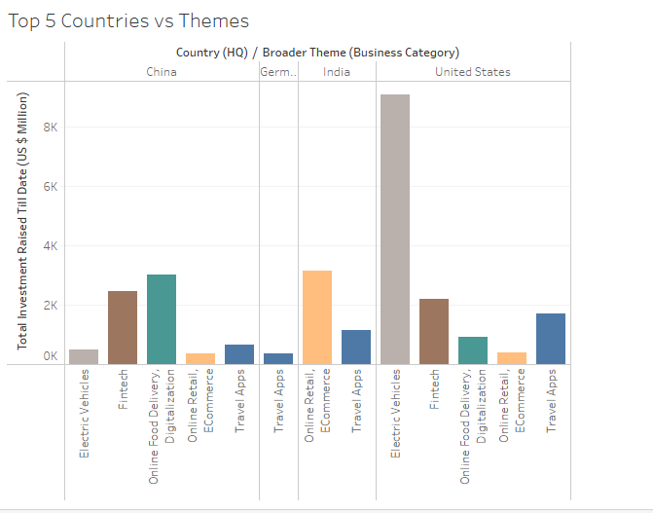
Top 5 Countries vs Start-ups

Slide 6
Top 5 Countries vs Start-ups
The Previous Slide represents the Broader Theme (Business Category) of Start-ups made.
We can able to see that Developing countries like India is having more start-ups in e-Commerce while developed Nations like US is having more Start-ups in future technologies like electric vehicles.

Slide 7
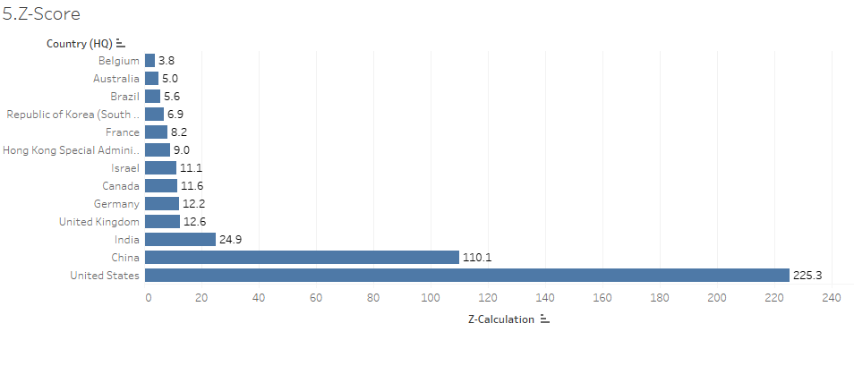
Z-Score Based on Investments

Slide 8
Z-Score Based on Investments
While we had calculated the Z-score with resultant values >= 3.5 and the countries are represented based on Investments.
We can see that the USA being the High on Investments and we can see Belgium (3.8) is nearest greater than 3.5 reference value of Z-score.

Slide 9
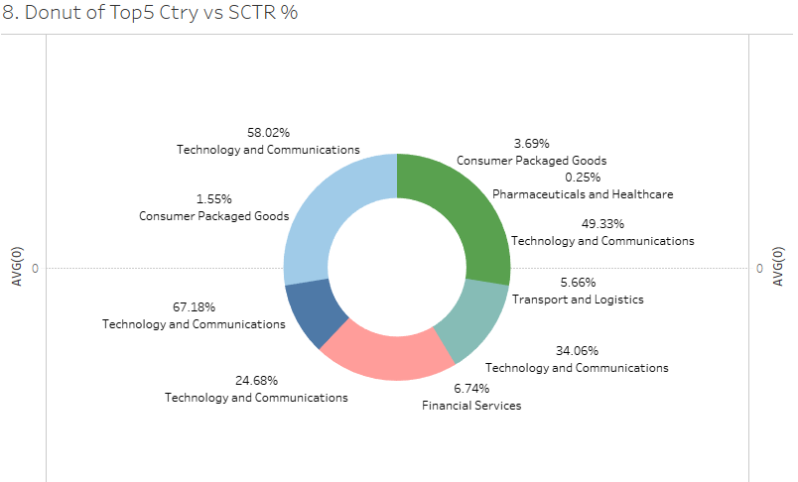
Top 5 Countries vs Sector %

Slide 10
Top 5 Countries Vs Sector %
The Donut Chart represents the percent wise sector presence of Top 5 countries within the start-ups.
We can clearly See the countries are investing more into Technology and communications rather than other sectors.

Slide 11
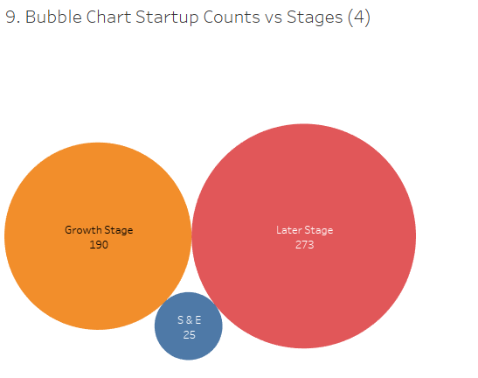
Stages of Startups

Slide 12
Stages of Starups
We can see the Later Stage of start-ups are more compared to seed and early stages and growth stages

Slide 13
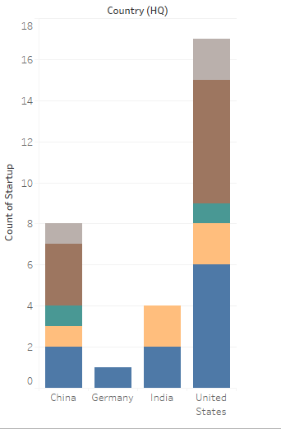
Top 5 Countries Vs Start-up Count

Slide 14
Top 5 Countries Vs Start-up Count
From the Graph we can see the US have travel app and Fintech being equal high out of other start-ups
India Being concentrated on e-Commerce and Travel Apps
China is also having more investment in Fintech
The Travel apps is the most common start-up within the Top 4 Countries .

Slide 15
Conclusion
Through various analysis what we had made through Tableau, we are able to study the patters of start-ups evolved over the sectors, Broader Themes (Business Category) and the total revenue they had made.
People were in search of Travel apps and Fintech most likely and the countries were having huge Investments in Technology and Communications rather than other areas.

